Slide 1





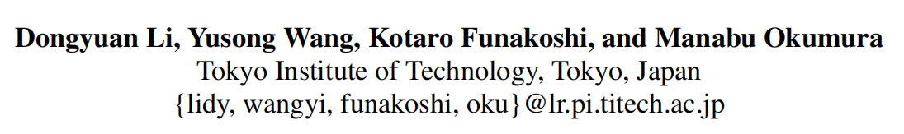





ATAI
Advanced Techniqueof Artificial Intelligence
ATAI
ChongqingUniversity _{AdvancedTechniqueof}
of Technology Artificial Intelligence
Chongqing University of
Technology
Chongqing University ^{ATAI}
_{of Technology} Advanced Techniqueof
Artificial Intelligence
Chongqing University of Technology
Chongqing University of Technology
Joyful: Joint Modality Fusion and Graph Contrastive Learning for
Multimodal Emotion Recognition
Code:https://github.com/wykstc/MERC-main
2024.2.1 •ChongQing
—— EMNLP 2023
Reported by YaoChen Li
1

Slide 2

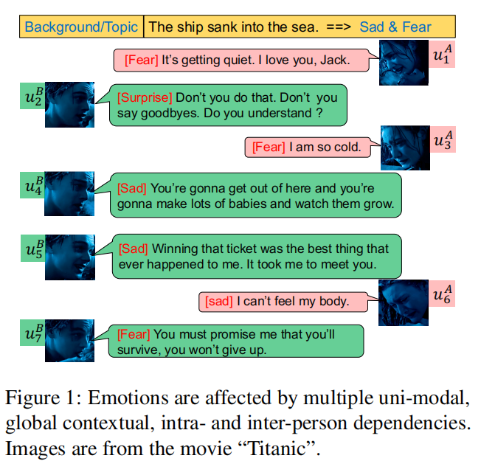
ATAI
AdvancedTechniqueof
Artificial Intelligence
ATAI
ChongqingUniversity _{AdvancedTechniqueof}
of Technology Artificial Intelligence
ChongqingUniversity of Technology
Motivation
(1) Current methods directly aggregate features of multiple modalities and ignore global contextual information, leading to poor performance.
(2) Since all graph-based methods adopt GNN or GCN, with the number of layers deepening, the phenomenon of over-smoothing starts to appear, resulting in the representation of similar sentiments being indistinguishable.

Slide 3

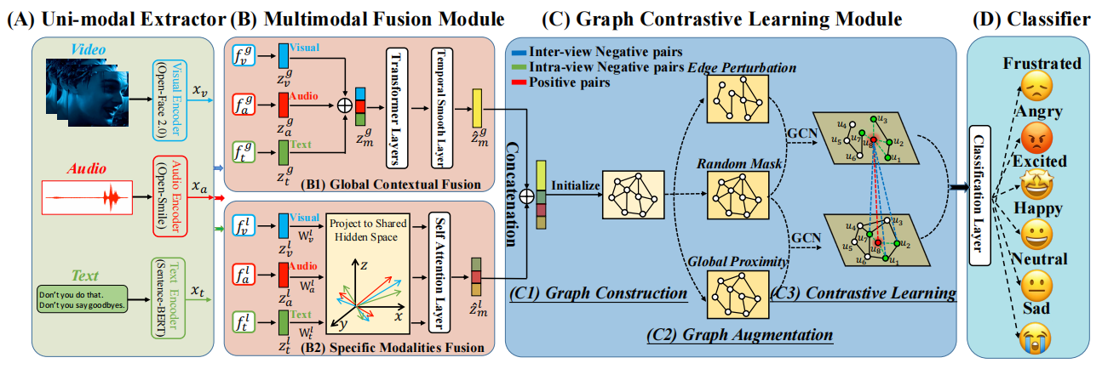
ChongqingUniversity of Technology
ATAI
AdvancedTechniqueof
Artificial Intelligence
ATAI
ChongqingUniversity _{AdvancedTechniqueof}
of Technology Artificial Intelligence
Overview

Slide 4

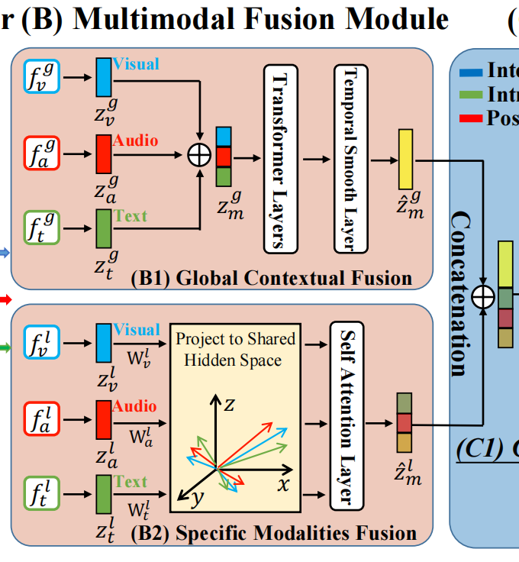





ChongqingUniversity of Technology
ATAI
AdvancedTechniqueof
Artificial Intelligence
ATAI
ChongqingUniversity _{AdvancedTechniqueof}
of Technology Artificial Intelligence
Method

Slide 5
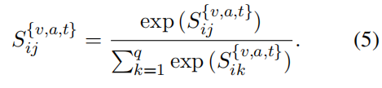



ChongqingUniversity of Technology
ATAI
AdvancedTechniqueof
Artificial Intelligence
ATAI
ChongqingUniversity _{AdvancedTechniqueof}
of Technology Artificial Intelligence
Method

Slide 6
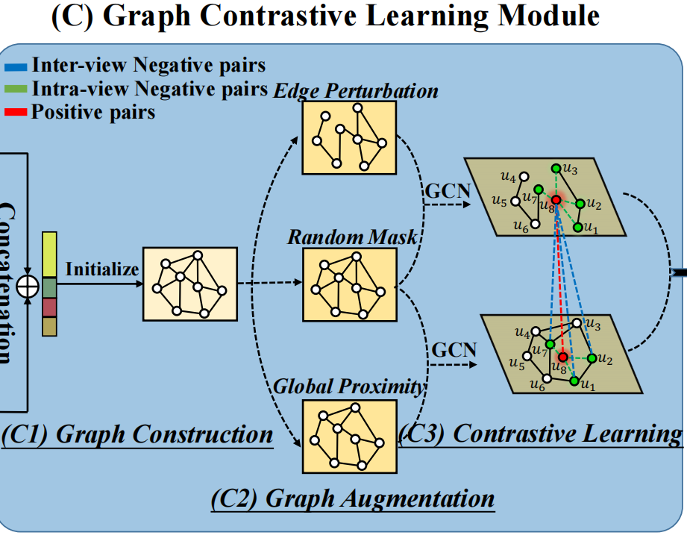

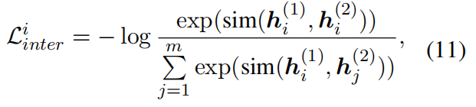
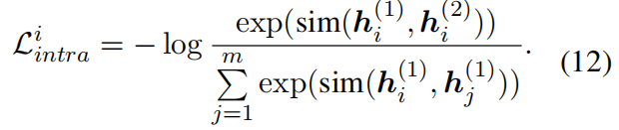
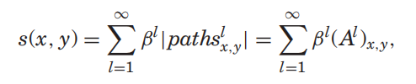
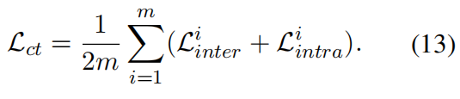
ChongqingUniversity of Technology
ATAI
AdvancedTechniqueof
Artificial Intelligence
ATAI
ChongqingUniversity _{AdvancedTechniqueof}
of Technology Artificial Intelligence
Method

Slide 7
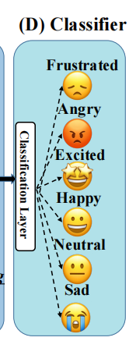
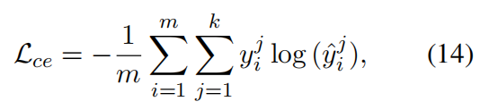

ChongqingUniversity of Technology
ATAI
AdvancedTechniqueof
Artificial Intelligence
ATAI
ChongqingUniversity _{AdvancedTechniqueof}
of Technology Artificial Intelligence
Method

Slide 8

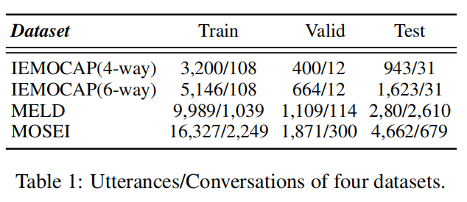
ATAI
AdvancedTechniqueof
Artificial Intelligence
ATAI
ChongqingUniversity _{AdvancedTechniqueof}
of Technology Artificial Intelligence
ChongqingUniversity of Technology
Experiments

Slide 9
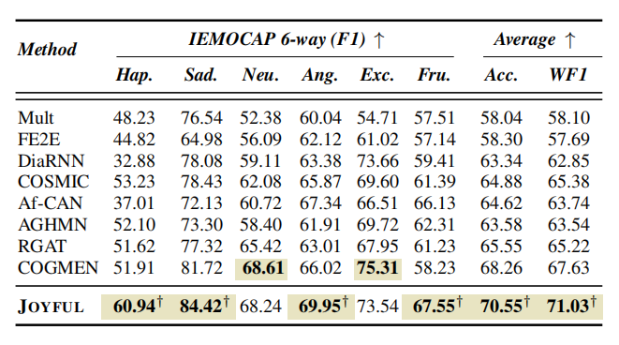
ATAI
AdvancedTechniqueof
Artificial Intelligence
ATAI
ChongqingUniversity _{AdvancedTechniqueof}
of Technology Artificial Intelligence
ChongqingUniversity of Technology
Experiments
Table 2: Overall performance comparison on IEMOCAP (6-way) in the multimodal (A+T+V) setting. Symbol † indicates that JOYFUL significantly surpassed all baselines using t-test with p < 0.005.

Slide 10
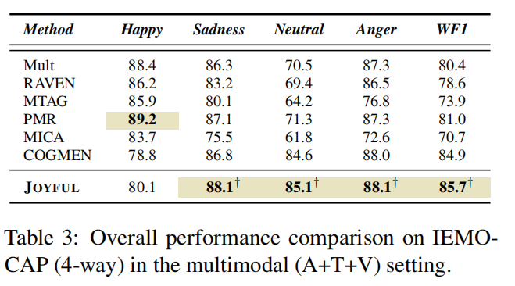
ChongqingUniversity of Technology
ATAI
AdvancedTechniqueof
Artificial Intelligence
ATAI
ChongqingUniversity _{AdvancedTechniqueof}
of Technology Artificial Intelligence
Experiments

Slide 11
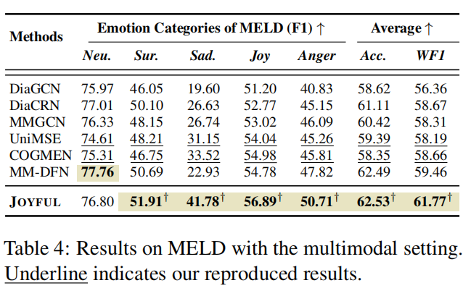
ChongqingUniversity of Technology
ATAI
AdvancedTechniqueof
Artificial Intelligence
ATAI
ChongqingUniversity _{AdvancedTechniqueof}
of Technology Artificial Intelligence
Experiments

Slide 12
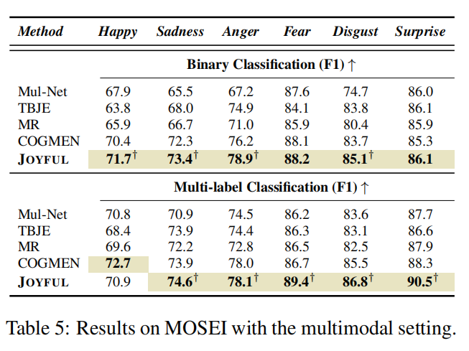
ChongqingUniversity of Technology
ATAI
AdvancedTechniqueof
Artificial Intelligence
ATAI
ChongqingUniversity _{AdvancedTechniqueof}
of Technology Artificial Intelligence
Experiments

Slide 13
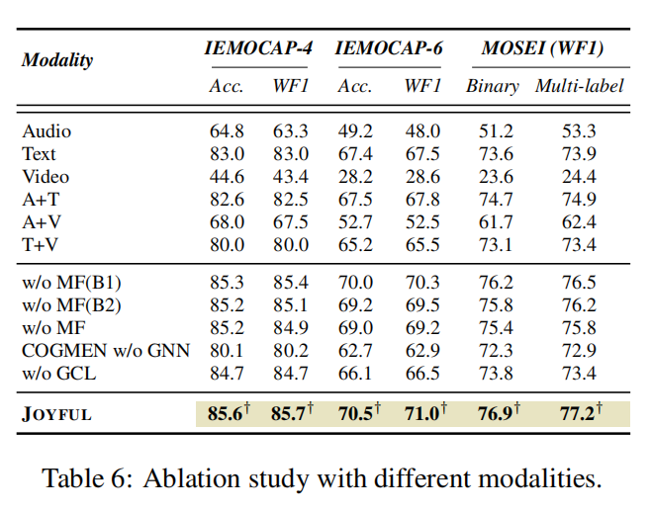
ChongqingUniversity of Technology
ATAI
AdvancedTechniqueof
Artificial Intelligence
ATAI
ChongqingUniversity _{AdvancedTechniqueof}
of Technology Artificial Intelligence
Experiments

Slide 14
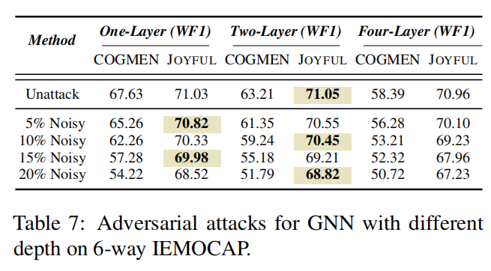
ChongqingUniversity of Technology
ATAI
AdvancedTechniqueof
Artificial Intelligence
ATAI
ChongqingUniversity _{AdvancedTechniqueof}
of Technology Artificial Intelligence
Experiments

Slide 15
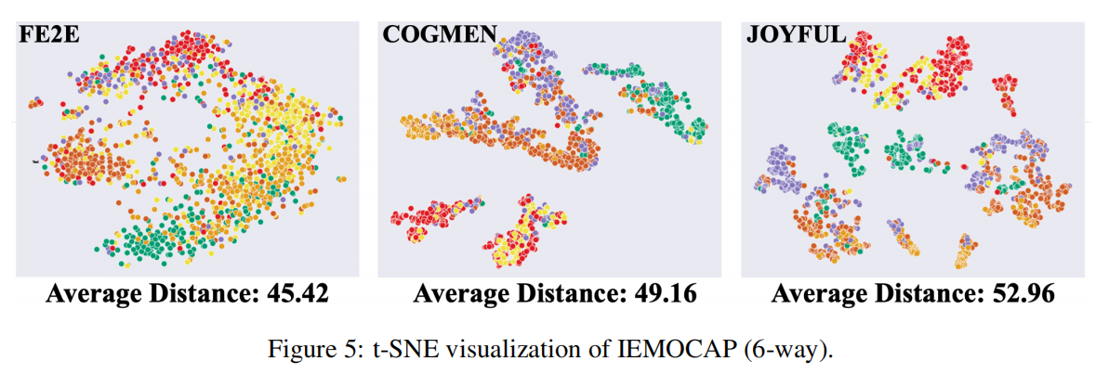
ChongqingUniversity of Technology
ATAI
AdvancedTechniqueof
Artificial Intelligence
ATAI
ChongqingUniversity _{AdvancedTechniqueof}
of Technology Artificial Intelligence
Experiments

Slide 16
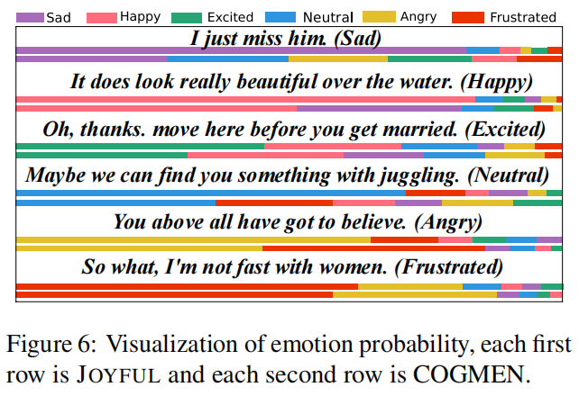
ChongqingUniversity of Technology
ATAI
AdvancedTechniqueof
Artificial Intelligence
ATAI
ChongqingUniversity _{AdvancedTechniqueof}
of Technology Artificial Intelligence
Experiments

Slide 17


ChongqingUniversity of Technology
ATAI
AdvancedTechniqueof
Artificial Intelligence
ATAI
ChongqingUniversity _{AdvancedTechniqueof}
of Technology Artificial Intelligence
Thanks!

